Slide 1
Pulling back the curtain with SeaGL Tech
AJ Jordan

Slide 2
About moi
Seattle/NYC
he/they
Firefox, Emacs, Fedora Silverblue
Tinkerer, self-hoster
January (consumer credit)
Longtime SeaGL attendee
Shorter time SeaGL Tech committee co-chair

Slide 3
What’s a Tech committee to do?
Virtual conference experience
  Livestreaming and A/V
Year-round infrastructure
  Writing new stuff
  Deploying existing stuff
  Maintaining lots of stuff!
Website
Misc. things that come along with the above

Slide 4
We couldn’t do it without the open source/free software community.

Slide 5
Time
Volunteer time
Time before the conference

Slide 6
Sustainability
How can we make software do this work for us?
How can we take advantage of mini economies of scale?
  How can we take advantage of the community?
How can we help the rest of the conference do the same thing?

Slide 7
OSEM circa December 2021
(Famously) many years diverged from upstream
Manually deployed to an EC2 machine
Nobody knew exactly how
Bad shape.

Slide 8

A hero emerges

Slide 9
Dokku
“Open source Heroku”
git push and Dokku will Just Work™
  Install your dependencies
  Run your build scripts
  Deploy and monitor your app bundle
  Let you scale* your app
  Zero-downtime deploys
  Let’s Encrypt certs

Slide 10
Service vs. capability
Dokku allows us to separate these
It gives us a deployment capability that we maintain only once

Slide 11
Now on Dokku...
Patch
maubot-rss
mauliasproxy
Mjolnir
OSEM

Slide 12
Soon on Dokku!
Vaultwarden
matrix-appservice-irc(?)

Slide 13
Ansible
Configuration management tool
Version control
Automatically deployed to production with GitHub Actions
  Sustainable
  Accessible
Not currently public (secrets)

Slide 14

Another hero emerges!

Slide 15
OSUOSL
Oregon State University Open Source Lab
Great people
Common services for open source projects
Similar to Software Freedom Conservancy
Sustainability
osuosl.org

Slide 16
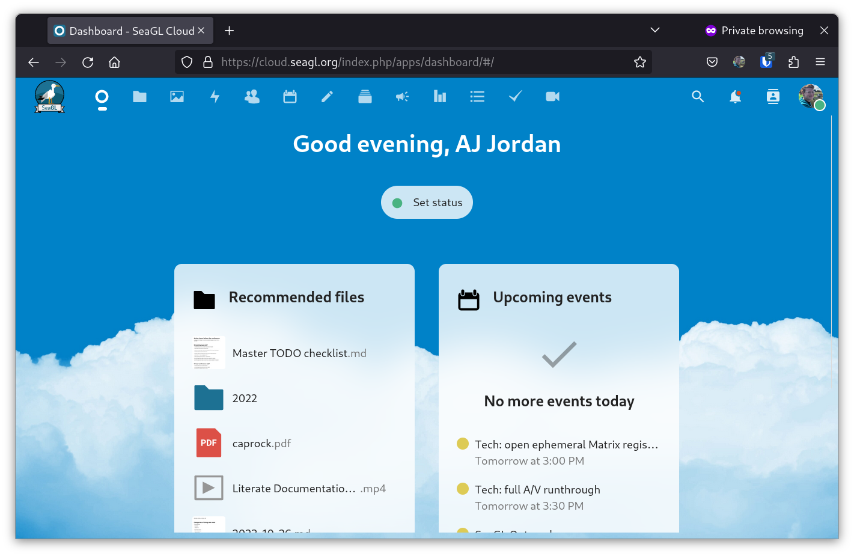
Nextcloud

Slide 17
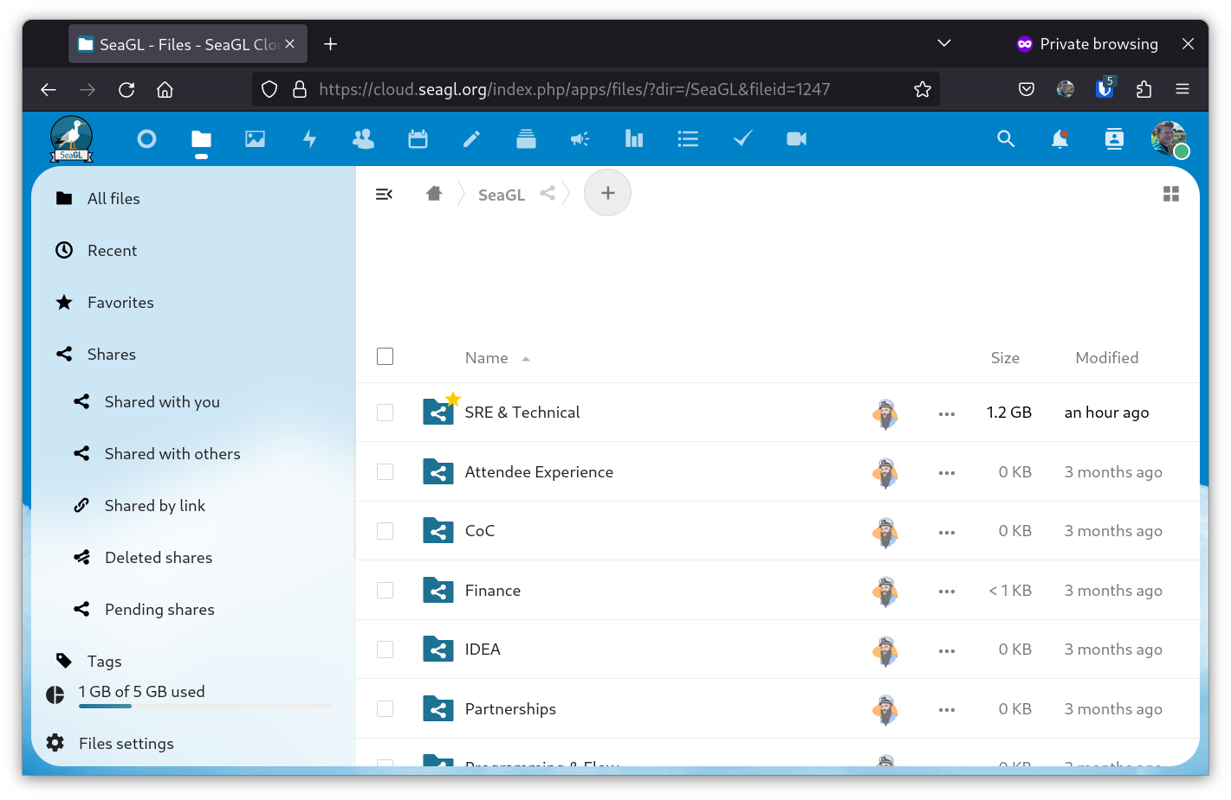
Nextcloud

Slide 18
Nextcloud
Our path to getting off Google for Work
Nextcloud Forms!
Speaker video intake
Now available for any other OSL project, too
  Chef

Slide 19
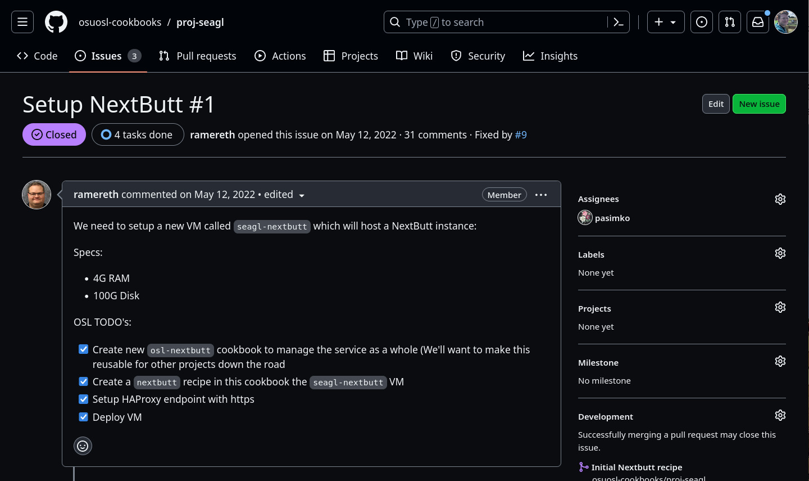
Nextcloud

Slide 20
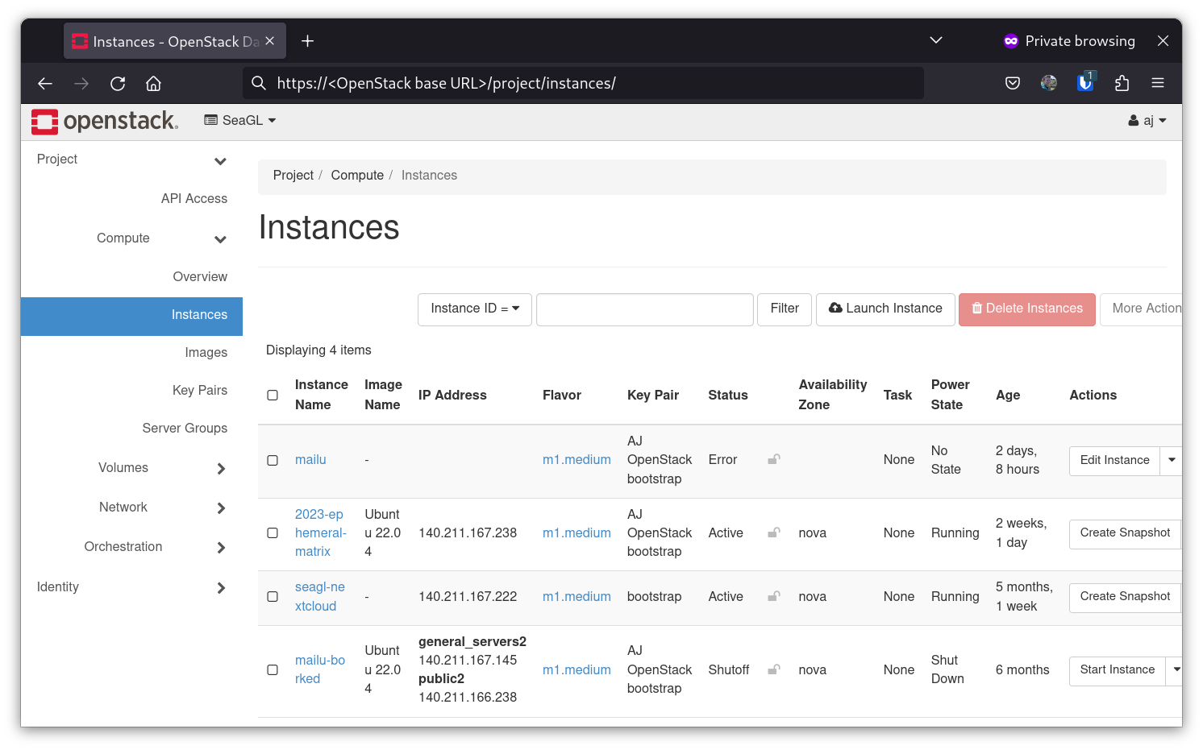
OpenStack

Slide 21
OpenStack
Open source common cloud infrastructure
  The path to get (mostly) off AWS
Lets us spin up our own VMs
  2023 Matrix accounts
  Soon: Mailu
    Open source full email stack
  Soon: Dokku

Slide 22
Some other important things
OBS
Restreamer
Element
Internet Archive
GitHub Pages
Sentry

Slide 23
Seattle Matrix
Shared infrastructure
  Jitsi
  Etherpad
  Matrix homeserver

Slide 24
Things we’d love to do
Improve tooling around conference task management
Fully free/libre A/V stack
PeerTube
IRC bridge
More software development
  Improvements to OSEM
More automation
  Laptop imaging and OSL-hosted OBS
  2023 attendee Matrix homeserver
A SeaGL LibreOffice Impress template

Slide 25
THANK YOU
Seattle
Matrix

Slide 26


THANK YOU

Slide 27
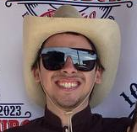

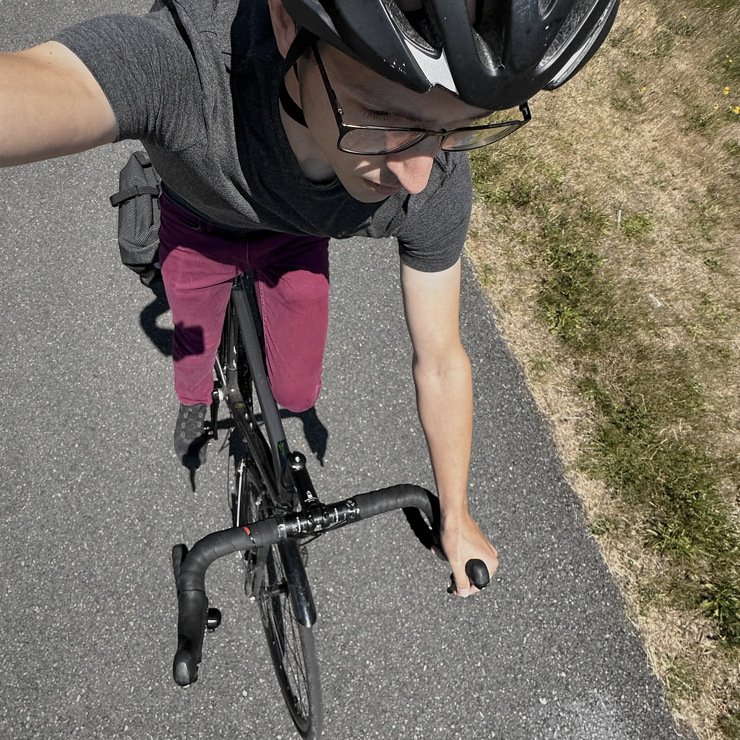
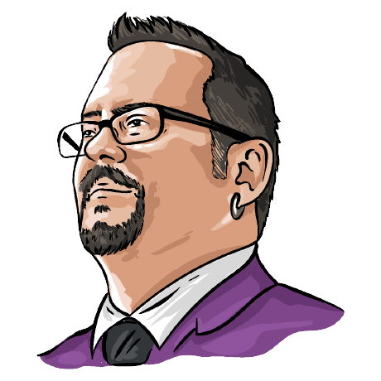
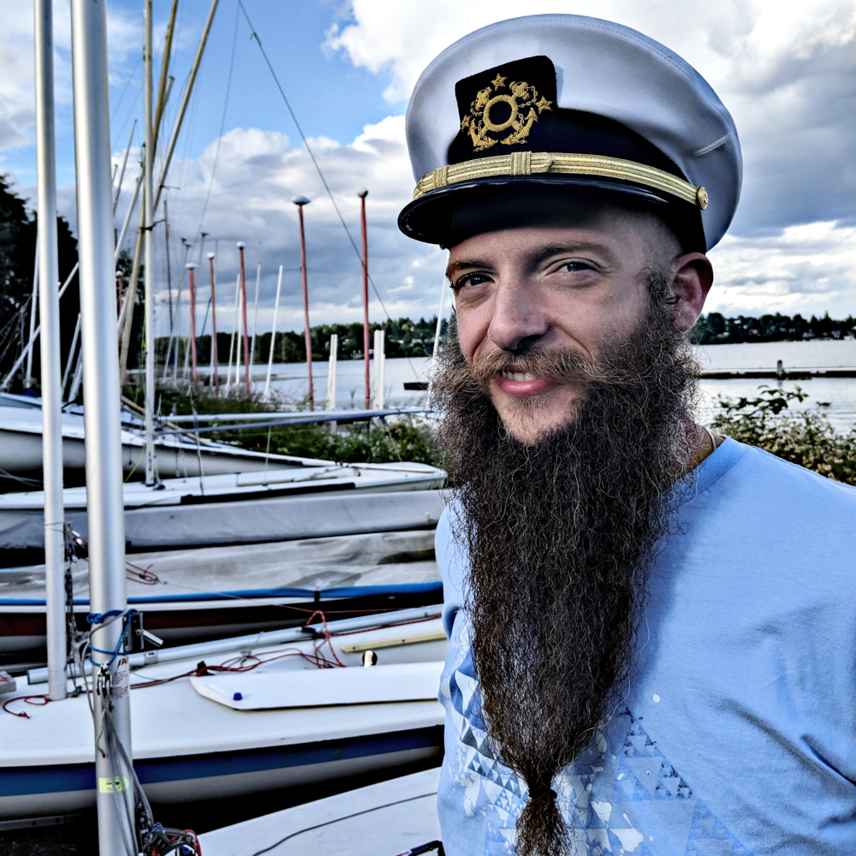

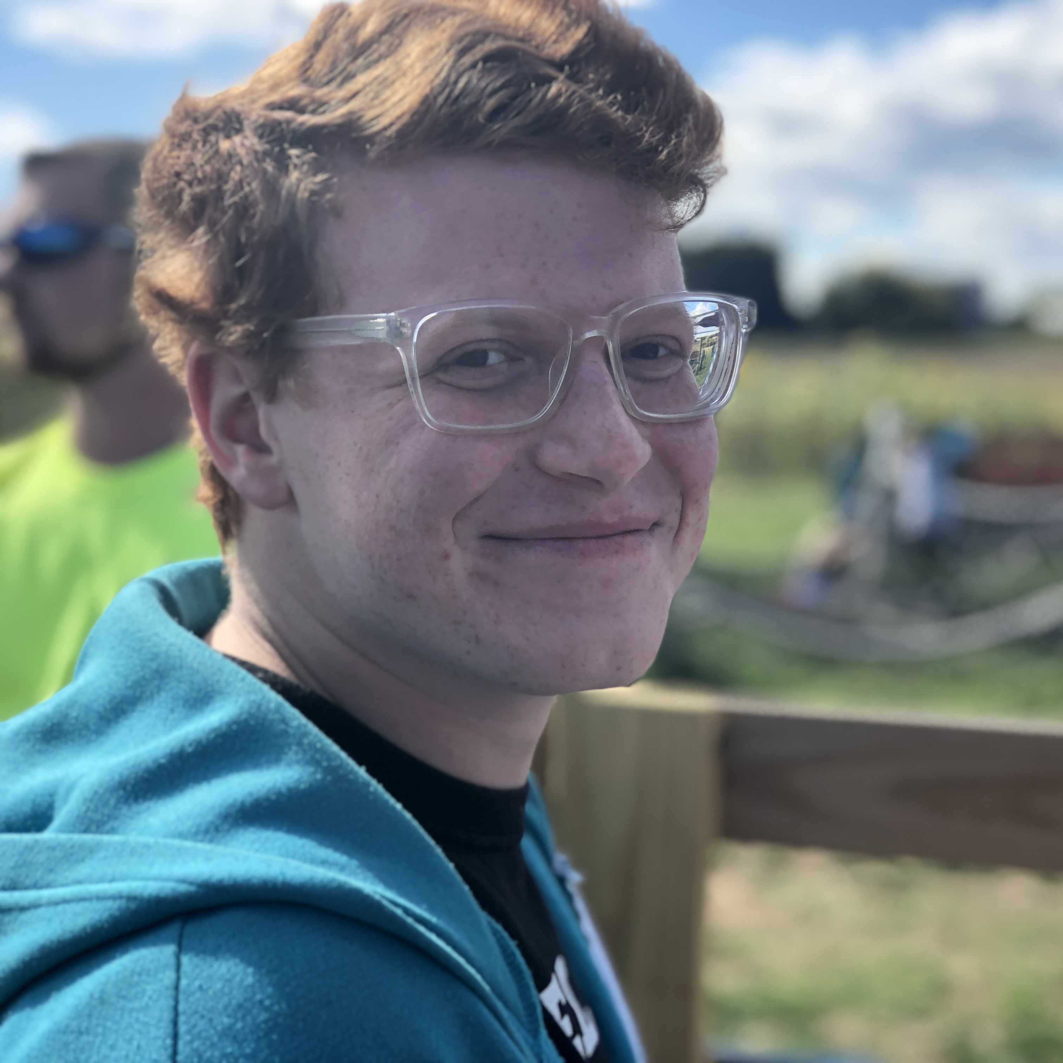
THANK YOU

Slide 28
THANK YOU
january.com/careers or just apply

Slide 29
Socials
strugee.net
alex@strugee.net
@strugee@tech.lgbt
github.com/strugee
seagl.org
participate@seagl.org
@SeaGL@mastodon.social
github.com/SeaGL
These slides are available on strugee.net/talks.

Slide 30
Come volunteer!
Questions?

